Slide 1
Computer Programming Ⅰ (COSE101)
Project 1. KU Mobile Phone Bill Calculator
2019 Spring Semester
Prof. Sungdeok Cha, Junbeom Hur
TA. JinHee Lee, Hyundo Yoon, Hodong Kim

Slide 2
Environment
OS: Windows 10
IDE: Visual Studio 2017
Language: C (‘C’ only. If use any of ‘C++’, will get 0 point.)

Slide 3
Computer Programming Project 1
Program your own ‘KU Mobile Phone Bill Calculator’.

Slide 4
KU Mobile Phone Bill Calculator
Your program should display the main menu providing following functions.
Display plans
Usage information for past two months
Input this month usage
Total fee for past 3 months
Best plan recommendation
Exit
A user can execute each function by entering corresponding number as input.
Each option must provide ‘back to main menu’ functionality as default.

Slide 5
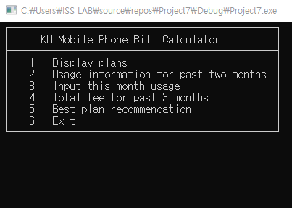
Example of main menu

Slide 6
Displaying Plans
Your program will displays two pre-defined plans. The two pre-defined plans are as follows.
 | Basic Plan
 | Included in plan | Additional usages
Voice | 500 min free calls | ￦50 / 1 min
Text | 100 free text messages | ￦10 / 1 text message
Data | 2.00 GB free data | ￦1000 / 0.1 GB
Basic fee | ￦ 20000
More Data Plan
Included in plan | Additional usages
300 min free calls | ￦10 / 1 min
100 free text messages | ￦30 / 1 text message
30.00 GB free data | ￦500 / 0.1 GB
￦ 45000

Slide 7
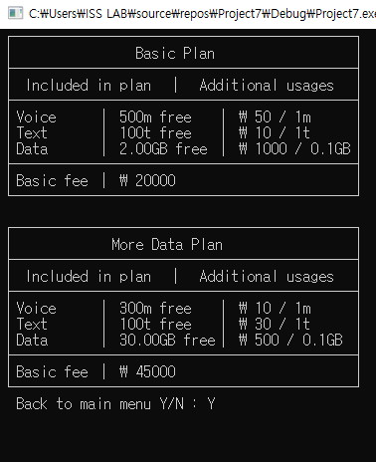
Displaying Plans
You have to display pre-defined mobile billing plans

Slide 8
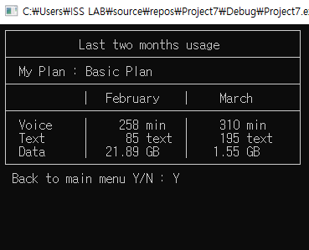
Past 2 months’ usage information
For the past two months, your program must display the following information for each month
User’s plan
Usage of voice
Usage of text
Usage of data
Current plan, and usages are determined randomly with following conditions when your program begins.
Current plan: one of pre-defined plans
Usages of voice: from 1 to 700 min
Usages of text: from 0 to 300 messages
Usages of data: from 0.50 to 150.00 GB

Slide 9
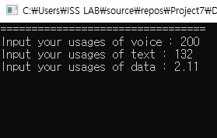
Input this month Usage
Input your usage of voice, text, and data for current month
Usages of voice
Usages of text messages
Usages of data

Slide 10
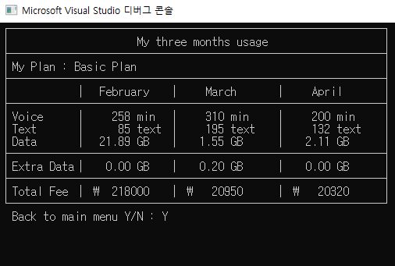
Fee of Past 3 Months
Your program must show billings for the past three months
Billings include the following information
Usage of voice, text, data for each month
Extra data that will be carried over to next month
If you consume data below free tier in a month, the unconsumed data can be carried over to the next month
But, the amount carried over cannot exceed 10% of the total amount of free tier in a month
Ex) Free tier = 30GB, used = 25GB, Carried over = 3GB
Fee of each month

Slide 11
Best plan recommendation
Your program must recommend the best plan based on user’s average usages of the past three months.
The best plan is the one providing service with the lowest total fee.
The best plan is determined based on the average usages for the past three months (including this month).
During the average usage calculations, round off to each unit of service.
Ex) 1st month: 350 min, 100 texts, 3.25 GB
2nd month: 424 min, 200 texts, 2.15 GB
3rd month: 200 min, 50 texts, 10.00 GB
Average usages: 324 min, 116 texts, 5.13 GB

Slide 12
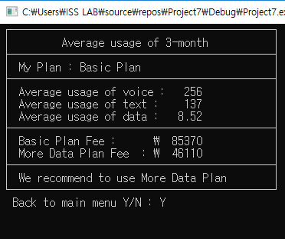
Best plan recommendation (cont.)

Slide 13
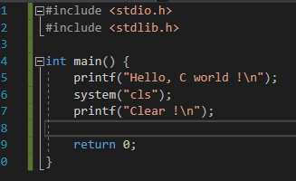

Note
When you want to clean CMD, you can use system(“cls“);.
<stdlib.h> includes this function.

Slide 14
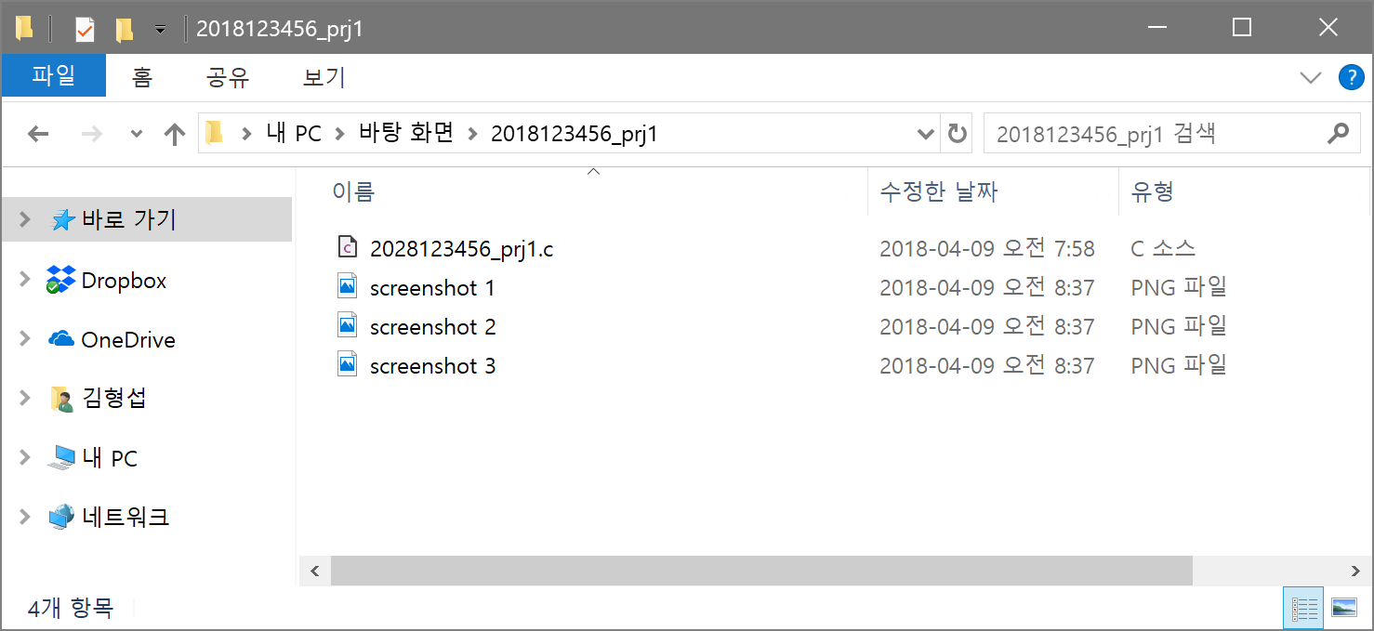
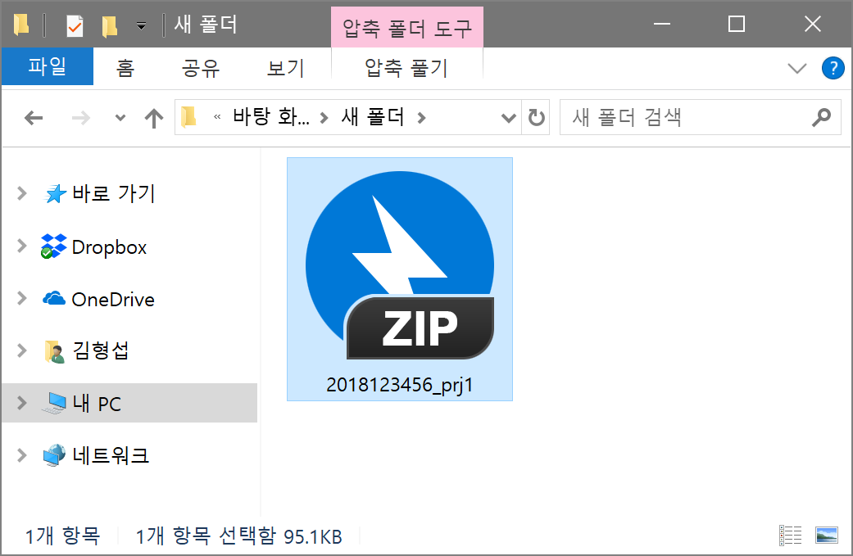
Submission Format
Submit a file ‘Student ID_prj1.zip’
Source file of your program ‘Student ID_prj1.c’
Several screenshots of your program ‘screenshot #.png’
BlackBoard (kulms.korea.ac.kr)

Slide 15
Submission Due Date
Due date: 2019/05/01 (1st, May), 23:59
Please submit earlier than dead line. Late submission will not be accepted with any reason.
ex) Errors on the blackboard
Plagiarism (or cheating): 0 point with no exception.
Sharing source code with friends in person
Post up a solution on the personal blog or SNS in public
Or, any kind of academic dishonesty will be seriously penalized

